Slide 1
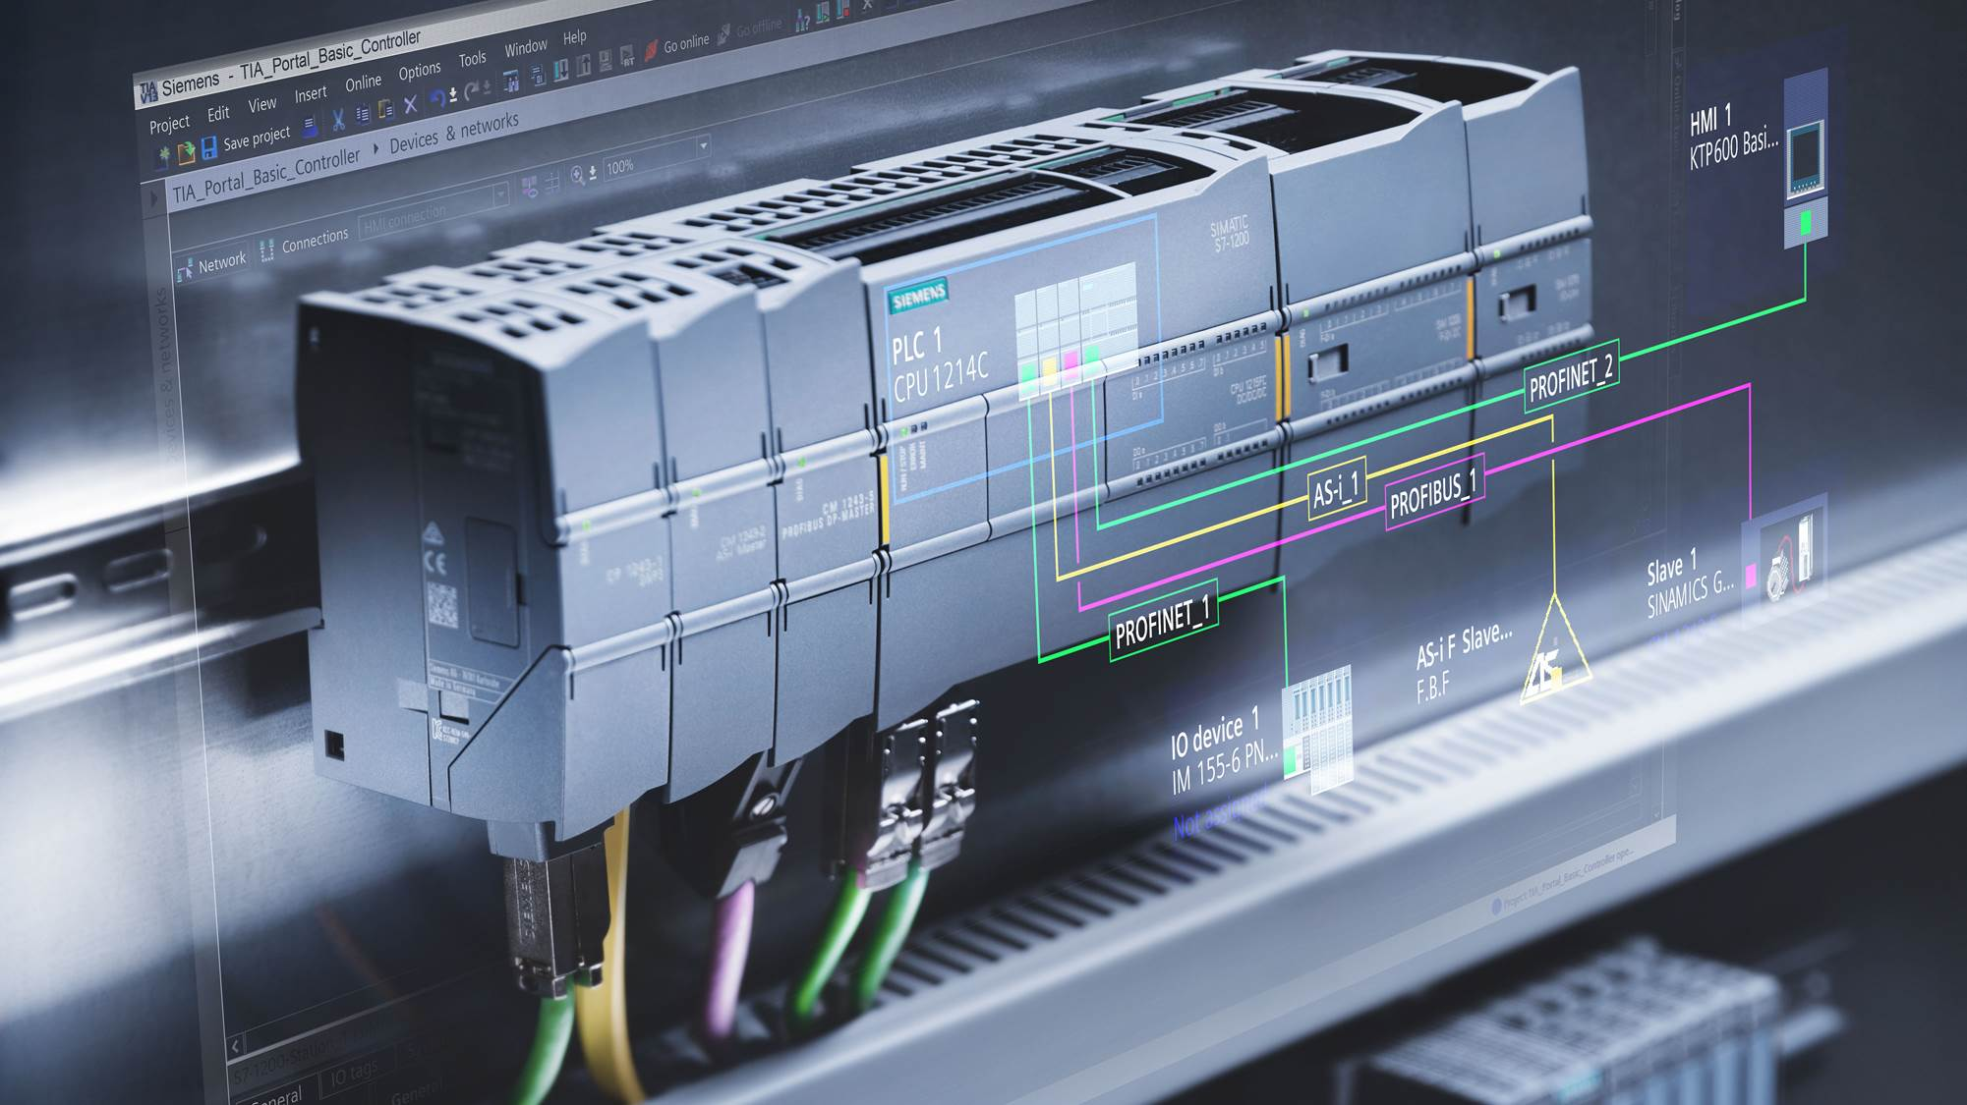
SIMATIC S7-1200 Basic Controller in the TIA Portal
Unrestricted © Siemens AG 2017
Technical slides
Notes:
S7-1200 and TIA Portal Software
The S7-1200 is the successor to the S7-200 and has been developed for the global market.
The SIMATIC S7-200 products have been discontinued since 1/10/2013. They will still be available as new parts for one further year until 1/10/2014. They can then be ordered as spare parts for a further 9 years. Products from the SIMATIC S7-1200 range should be used with the STEP 7 Basic configuration software for new applications.
The TIA Portal is used with STEP 7 Basic for programming the S7-1200 (ordered separately from the hardware). - This includes program editors for the COP (Contact Plan), FUP (Functional Plan) and SCL (Structured Control Language).
- AWL programming (for the instruction list) is not supported.
- It includes WinCC Basic for configuring the HMI Basic Panels. - No separate USB license stick is required. The software is automatically activated during installation.
Windows Explorer and data compression can be used to copy the project directory structure in order to move project files between PCs.
Approvals for the S7-1200
The S7-1200 hardware has received the approvals required for the US and European markets.
The S7-1200 has cFMus approval for explosive areas:
The Factory Mutual Research FM: Approval Standard Class Number 3600 and 3611 Approved for use in: - Class I, Division 2, Gas Group A, B, C, D, Temperature Class T3C, Ta = 60°C - Class I, Zone 2, IIC, Temperature Class T3 , Ta = 60°C
The S7-1200 hardware has the cULus and CE approvals.

Slide 2
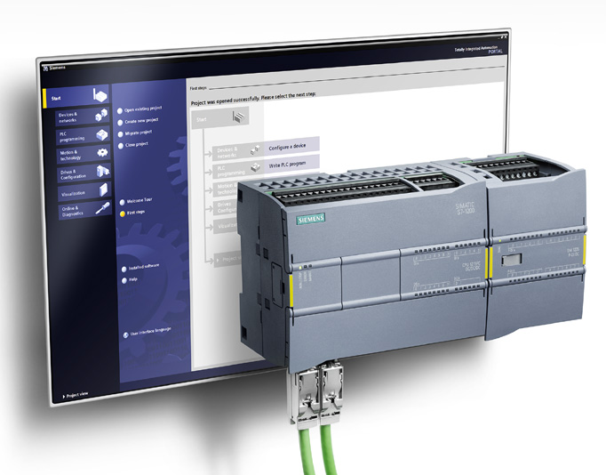
SIMATIC Controller S7-1200
Efficient engineering
+
Security Integrated.
+
Diagnostics
+
+
Technology Integrated
+
High performance
+
+
Innovative design and easy
to use
Safety Integrated

Slide 3
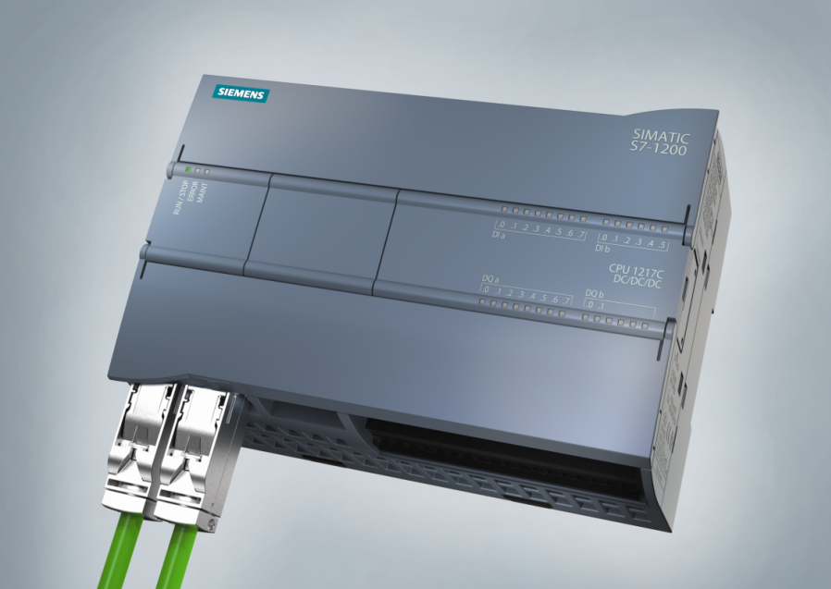
SIMATIC S7-1200 configured in the TIA Portal Fits perfectly
Modular space-saving controller for automation systems requiring simple or extended functionality in the area of logic, HMI and networking.
Perfect for stand-alone and interconnected machines and cost-effective automation solutions
Simple integration into interconnected systems and into systems that require one or more HMI devices
Extended functionality for small motion control systems and small process applications
Controller, HMI and networking: everything developed in one software architecture

Slide 4
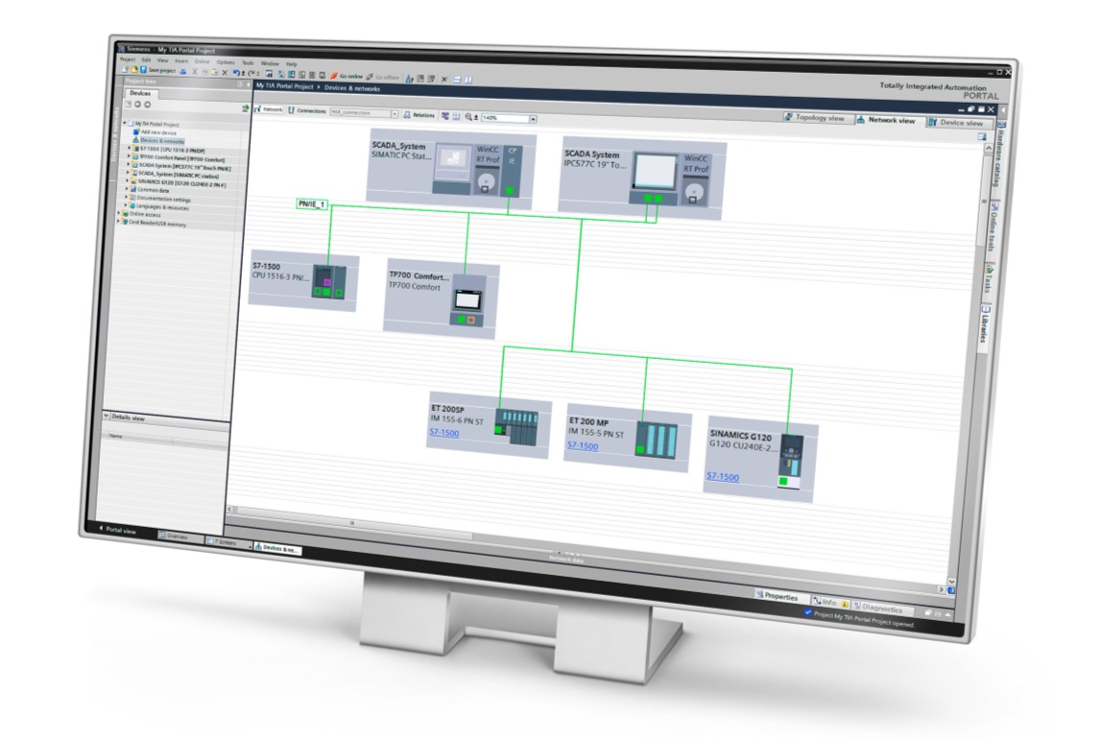
SIMATIC S7-1200 configured in the TIA Portal Modular and powerful.
Uniform software for hardware, HMI and network configuration – through a uniform user concept, common data storage and centralized services
Code modularity – allows existing automation parts such as an SCL program to be reused in another product series.
Common project concept – Automatic detection between multiple controllers with multiple HMI devices without having to maintain separate user programs for every device. One user program is possible for the entire system.
Shorter engineering and service periods through an efficient uniform programming environment.
Notes:
Three Areas of Innovation
System Architecture
The system architecture is designed from the Inside Out not the Outside In. The combined design of the controller hardware, the HMI hardware and all firmware share a common set of intelligence with the Engineering Software, eliminating traditional barriers of interoperability between common automation devices (Controllers, HMI, Networks). This unified system architecture was traditionally only available in larger, specialized or PC-Based control platforms NOT in the smaller PLC classes.
This Integrated Automation design provides: **Pointing to the hardware images across the top**
Auto-detection between multiple controllers with multiple HMIs without the need to maintain separate user programs for each. There can be one user program for the system, or libraries you assemble for a modular system.
No need to use separate standalone utilities (and maintain separate configurations) for PID Loop Tuning, Motion Control using PLC Open instructions. Everything is built into the engineering software and included with the user program.
**Pointing to the software screen images to the left**
Step7 Basic represents one engineering software for Logic, HMI and Networking with a Common Editor. All navigation, icons, and menus are consistent throughout its Views. Easy to learn and maintain. No other Micro or Nano PLC competitor can provide this.
**Pointing to the PG Engineering Station middle-bottom**
Step7 Basic provides Instant-On Connections over Ethernet to all supported devices on the network. It is graphical and requires no configuration or multiple instances to connect to everything.
All user program documentation for the controller logic is stored in the CPU (symbols, network comments, descriptions, etc.) Offline program not required to see documentation, much easier and quicker maintenance
The result is a Common “Core Intelligence” for integrated automation in the Compact Controller class. Unique for the Micro or Nano PLC category

Slide 5
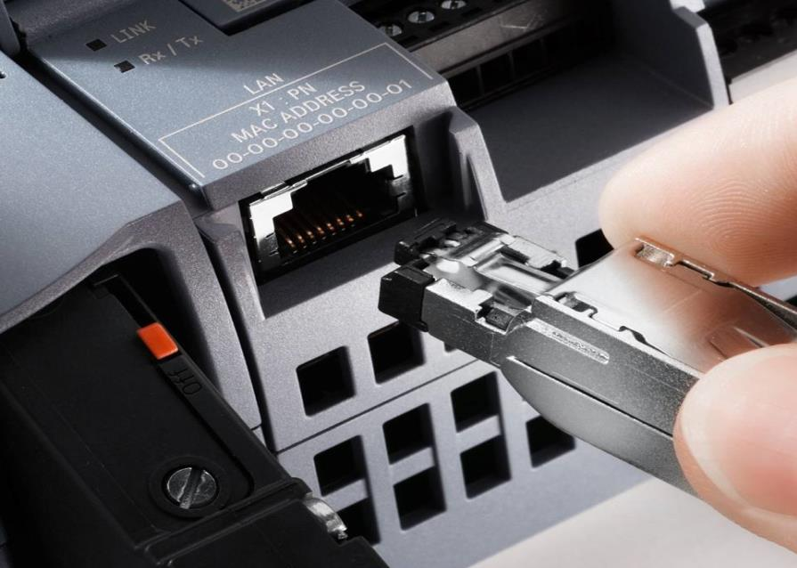
SIMATIC S7-1200 compact controllers Modular and powerful.
Integrated PROFINET/Ethernet Port – No additional proprietary programming cable and no Ethernet extension module required ➔ reducing space requirements and costs.
Scalable extension concept using modular boards – Signal boards for additional I/O ports, with no extra space required for the CPU. If you just need one RTD input: no problem!
Integrated digital I/O, analog I/O and Motion Control I/O – makes additional hardware superfluous; thereby reducing space requirements and costs.
Integrated PROFINET, modular boards and integrated I/O mix reduce costs.
Notes:
2. Hardware Innovation
More built-in hardware functionality within the CPU than any other Siemens Micro PLC. Integrated Ethernet, Analog I/O, Motion Control I/O, & SD Memory interface.
– eliminating the need for additional hardware; reducing space and cost
**Pointing to CPU and Graphics along the bottom**
Significantly reduced width compared to other MicroPLCs, including the S7-200. (e.g. increasing an enclosure width by only 6-inches can sometimes double its price)
Inputs on the top and Outputs on the bottom is an efficient design with smaller gage input wiring having longer runs to the top and shorter heavier gage loads on the bottom. More practical panel layout and lower wiring cost.
Full size 14AWG terminal blocks; many other MicroPLCs have barrier strip terminals and/or smaller block terminals, more difficult to wire
Durable industrial plastic with a nylon composite mix, not brittle ABS plastic that can break/crack easily like other Micro PLCs (AutomationDirect)
2AI channels are separate I/O points, not simply 2 configurable discrete points (loose no discrete points when using built-in 2AI channels)
Removable terminal blocks on both CPU and Signal Modules
Industrial grade metal RJ45 Ethernet port
Standard SD memory interface not a proprietary hardware design. Can insert SD memory into PG/PC and copy program without using an S7-1200 CPU
Unique front panel signal board interface for 2-DI/2-DO signal board or 1-AO. Add I/O without increasing panel space.
**Pointing to the Fully Assembled System**
The hardware design combines the best of a classic Brick MicroPLC design with top/bottom terminals for easy wiring along with modular expansion of the I/O to the right and Communication/Specialty Modules to the left. This provides an efficient panel layout with higher-current/inductive I/O loads on the right away from the communication signals on the left. Reduces the possibility of noise problems.
Resulting in compatible interfaces for easy integration, startup and reduced cost

Slide 6
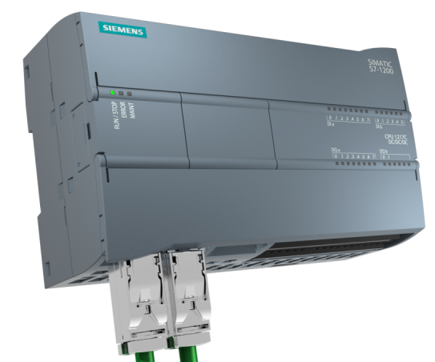

Design and handling S7-1200 CPU
Digital inputs
Analog inputs
Optional memory extension
Modular board concept
Integrated HSCs & PTOs/PWMs
Removable connectors
Digital outputs (DC or relay)
PROFINET interface (1 or 2 ports)
S7-1200: Modular. Powerful

Slide 7
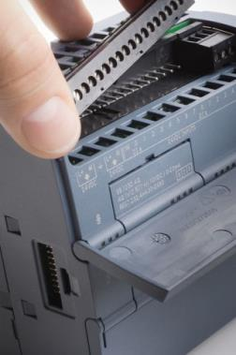
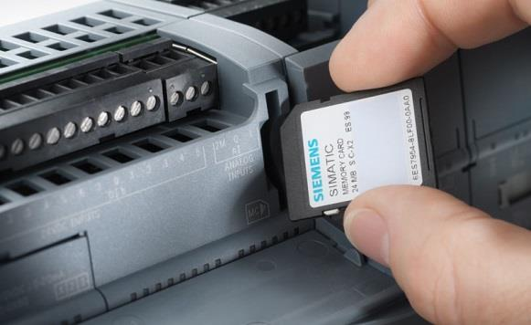
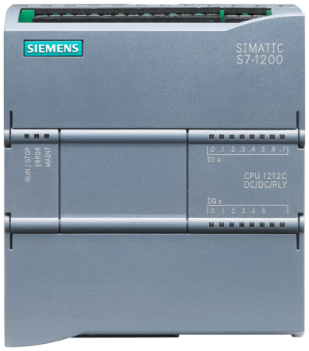
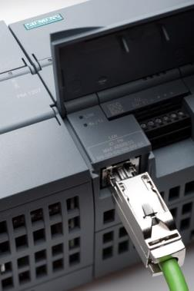
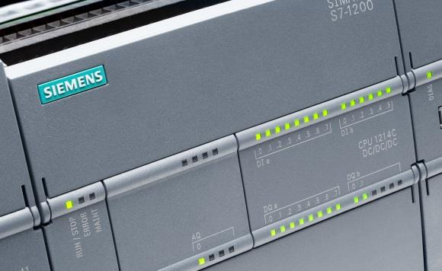
Design and handling S7-1200 CPU - setup
Power supply
Slot for a memory card below the upper cover flap
Plug-in terminal block for user wiring (behind the cover flaps)
Status LEDs for the integrated I/O
PROFINET connection (on the bottom of the CPU)

Slide 8



Design and handling Set-up and extension options - maximum
CM/CP
CPU
SM
1 Board
CPU 1211C
CPU 1212C
CPU 1214C / 1215C / 1217C
S7-1200: variable extension and set-up options for differing requirements

Slide 9
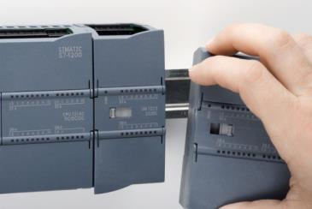
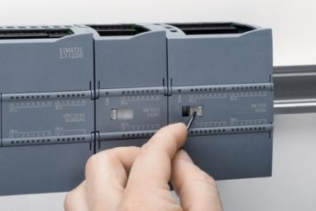
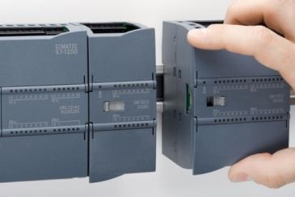

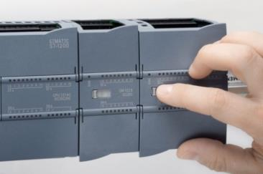

Design and handling Extension module assembly
Installation
Expansion
Remove backplane bus cover
Insert SM into standard mounting rails
Guide the SM to the adjacent module
Lock the standard rail mounting clamp
Guide the bracket for the bus connector contact to the left towards the adjacent module
Loosen the bus connector contact by pushing the bolt to the right
Move SM right onto standard mounting rail
Unlock standard mounting rail clamp
SM out of standard mounting rail

Slide 10
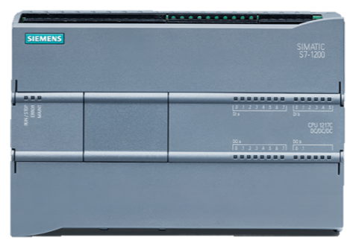
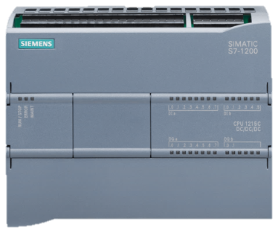
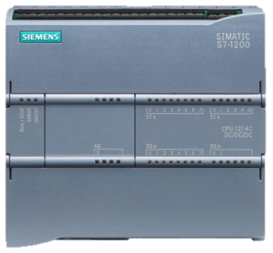
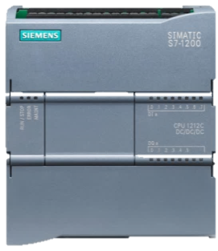
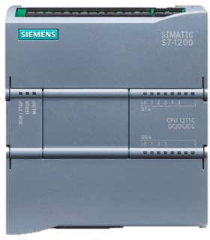
Design and handling CPU – 17 Versions incl. failsafe
CPU 1217C DC/DC/DC
CPU 1215C
…DC/DC/DC
…DC/DC/RLY
…AC/DC/RLY
CPU 1214C
…DC/DC/DC
…DC/DC/RLY
…AC/DC/RLY
CPU 1212C
…DC/DC/DC
…DC/DC/RLY
…AC/DC/RLY
CPU 1211C
…DC/DC/DC
…DC/DC/RLY
…AC/DC/RLY
S7-1200: variable extension and set-up options for differing requirements

Slide 11
Design and handling CPU dimensions
CPU 1217C DC/DC/DC
CPU 1215C
CPU 1214C
75
CPU 1212C
75
100
CPU 1211C
75
100
150
75
100
130
75
100
100
110
90
90
S7-1200: variable extension and set-up options for differing requirements

Slide 12
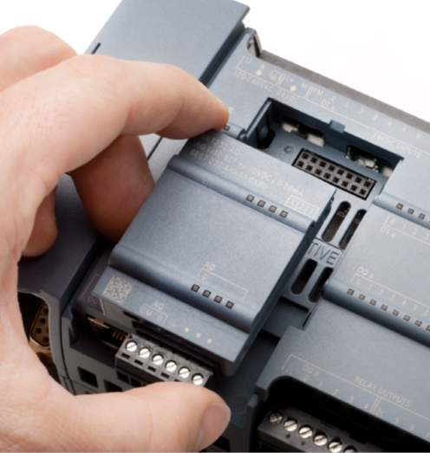
Design and handling Optional CPU functional enhancements using boards
Board type | Characteristics
SB 1221 | 4 DI, DC 5V, HSC with up to 200 kHz available for use
 | 4 DI, DC 24V, HSC with up to 200 kHz available for use
SB 1222 | 4 DQ DC 5V, 0.1 A, PWM with up to 200 kHz, PTO with up to 100 kHz available for use
 | 4 DQ DC 24V, 0.1 A, PWM with up to 200 kHz, PTO with up to 100 kHz available for use
SB 1223 | 2 DI, DC 5V, 2 DQ DC 5V, 0.1 A, HSC with up to 200 kHz, PWM with up to 200 kHz, PTO with up to 100 kHz available for use
 | 2 DI, DC 24V, 2 DQ DC 24V, 0.1 A, HSC with up to 200 kHz, PWM with up to 200 kHz, PTO with up to 100 kHz available for use
 | 2 DI, DC 24V, 2 DQ DC 24V, 0.1 A
SB 1231 AI | 1 AI, ±10VDC (12 bit) or 0…20 mA
SB 1231 RTD | 1 AI RTD, PT 100 and PT1000
SB 1231 TC | 1 AI thermal elements type J or K
SB 1232 AQ | 1 AO, ±10VDC (12 bit) or 0…20 mA (11 bit)
CB 1241 | RS485 communication board
BB 1297 | Battery board for real-time clock long-term buffering (without CR1025 battery)

Slide 13
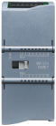
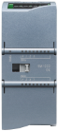
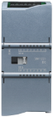
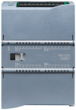
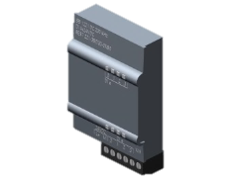
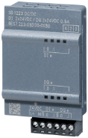
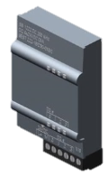
Design and handling Digital signal modules and signal boards
SM 1221 digital input |  | SM 1223 digital input/output |  | SM 1222 digital output
45 mm | 8 DI, 24V DC 16 DI, 24V DC SINK/SOURCE | 45 mm | DI 8x 24 VDC, DQ8 x RLY DI 8/DQ 8 24 VDC | 45 mm | DQ 8x RLY DQ 8x 24 VDC DQ 16x RLY
 |  | 70 mm | DI 16x 24 VDC, DQ 16x RLY DI 16/DQ 16 24 VDC DI 8 x120/230 V AC / DQ 8 x relays | 70 mm | DQ 8x RLY (changeover contact) DO 16x 24 VDC
SB 1221 digital input |  | SB 1223 digital input/output |  | SB 1222 digital output
 | 4DI, 5VDC 200kHz 4DI, 24VDC 200kHz Reading M |  | 2DI/2DQ 24VDC 2DI/2DQ, 5VDC 200kHz 2DI/2DQ, 24VDC 200kHz |  | 4DQ, 5VDC 200kHz 4DQ, 24VDC 200kHz

Slide 14
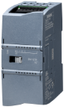
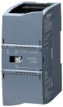
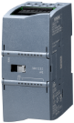
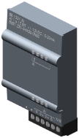
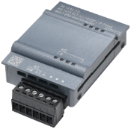
Design and handling Analog signal modules and signal boards
SM 1231 analog input |  | SM 1234 analog input/output |  | SM 1232 analog output
45 mm | 4 AI 13 bit, ±10V, ±5V, ±2.5V, or 0-20/4-20 mA 8 AI 13 bit, ±10V, ±5V, ±2.5V, or 0-20/4-20 mA 4 AI 16 bit, ±10V, ±5V, ±2.5V, or 0-20/4-20 mA 4 AI 16 bit TC 8 AI 16 bit TC 4 AI 16 bit RTD 8 AI 16 bit RTD | 45 mm | 4 AI 13 bit, ±10V ±5V or ±2.5V or 4-20 mA / 2 AQ 14 Bit, ±10V or 4-20 mA | 45 mm | 2 AQ, ±10V, 14 bit or 0 – 20 or 4 - 20 mA, 13 bit 4 AQ, ±10V, 14 bit or 0 – 20 or 4 - 20 mA, 13 bit
SB 1231 analog input |  |  |  | SB 1232 analog output
 | 1 AI, 12 bit ±10VDC or 0-20 mA 1 AI, 16 bit RTD (Pt) 1 AI, 16 bit TC (type: J,K; ± 80 mV) |  |  |  | 1 AQ, ±10V (12 bit) or 0 - 20 mA (11 bit)

Slide 15

Design und Handling Features SM 1238 ENERGY METER 480VAC
Power supply
SM1238
Energy Meter 480VAC
Inputs for voltage measurement
L1 and N directly connected to voltage input for power supply
L1 – L3 directly connected to the inputs without voltage transformer: 110V – 480V PH – PH
N
L1
No supply with 24V of the CPU
Voltage transformers are supported if necessary
Set transformer ratio for voltage > 480 V
Inputs for current measurement
45 mm width
Diag- LED
Support of TN and TT networks
backup of measured data: NV memory
HSP f. TIAP V13 SP1, ≥ CPU V4.1
Max. 8 SM 1238 at one CPU
L1 – L3 connected indirect with current transformer; 1 or 5A
Article Nr.: 6ES7238-5XA32-0XB0

Slide 16
Design und Handling SM 1238 ENERGY METER 480VAC Properties
Measurement of electrical variables from single-, two- and three-phase supply networks
Max. nominal voltage between 2 outer con-ductors 480 VAC (max. phase voltage 277 VAC)
Recording of:
Voltages
Currents
Phase angles
Power
Energy / electrical work
Frequencies
Minimum and maximum values
Power factors
Operating hours
Energy counter
The module supports the following functions:
Firmware update
I&M identification data
Reconfiguration in RUN
Diagnostics interrupts
Measuring access method (Module variants)
Read acyclically via data record
read cyclically for 19 defined data sets
EE@IndustryE0, E1, E2 and E3

Slide 17
Design and handling SIMATIC S7-1200 with FW4.2
SIMATIC S7-1200 CPU
CPU type
1211C
1212C
1212FC
1214C
1214FC
1215C
1215FC
1217C
PROFINET Ports
Work memory / int. load memory
50 kB 1 MB
75kB 2 MB
100kB 2 MB
100kB 4 MB
125kB 4 MB
125 kB 4 MB
150 kB 4 MB
150 kB 4 MB
Bit performance
85 ns
85 ns
85 ns
85 ns
85 ns
85 ns
85 ns
85 ns
Connection resources
38
38
38
38
38
38
38
38
Integrated Digital I/O
6/4
8/6
8/6
14/10
14/10
14/10
14/10
14/10
Integrated Analog I/O
2/-
2/-
2/-
2/-
2/-
2/2
2/2
2/2
High-Speed Counter
6
6
6
6
6
6
6
6

Slide 18
Design and handling S7-1200 CPU features (1/4)
 | CPU 1211C | CPU 1212C | CPU 1214C | CPU 1215C | CPU 1217C
CPU type | DC/DC/DC, AC/DC/RLY, DC/DC/RLY |  |  |  | DC/DC/DC
Work memory, integrated | 50 KB | 75 KB | 100 KB | 125 KB | 150 KB
Load memory, integrated | 1 MB |  | 4 MB
Retentive memory, integr. | 10 KB
Marker(M) | 4 KB |  | 8 KB
Integrated Digital I/O ¹⁾ | 6 inputs / 4 outputs | 8 inputs / 6 outputs | 14 inputs / 10 outputs
RS485 Differential I/O |  |  |  |  | 4 / 4 (1 MHz)
Integrated Analog I/O | 2 inputs |  |  | 2 inputs / 2 outputs
Process image size | 1024 bytes for inputs / 1024 bytes for outputs
Board (SB/CB) Expansion | 1 max.
Extension: Signal Module | none | 2 max. | 8 max.
Max. Local I/O – Digital | 14 | 82 | 284 | 284
Max. Local I/O – Analog | 3 | 19 | 67 | 69
1) See Technical Specifications for the number of inputs or outputs allowed on simultaneously. Some models are de-rated for 60°C horizontal mounting and 50°C vertical mounting

Slide 19
Design and handling S7-1200 CPU features (2/4)
 |  | CPU 1211C | CPU 1212C | CPU 1214C | CPU 1215C | CPU 1217C
High-speed counters | Total | Max. 6, configured for the use of integrated or SB inputs
 | 1 MHz | none |  |  |  | 4
 | 100 / 80 kHz ¹⁾ | 6
 | 30 / 20 kHz ¹⁾ | - | 1 | 3
 | 200 kHz | with SB 1221 DI 4x 24 VDC 200 kHz or SB 1221 DI 4x 5 VDC 200 kHz
Pulse outputs ²⁾ | Total | Max. 4, configured for the use of integrated or SB outputs
 | 1 MHz | none |  |  |  | 4
 | 100 kHz | 4
 | 20 kHz
Pulse Catch Inputs |  | 6 | 8 | 14
1) lower frequency with HSC configuration in 2-phase operation (A/B counter operation)
2) CPU versions with relay outputs require a digital signal board (SB) with use of pulse outputs

Slide 20
Design and handling S7-1200 CPU features (3/4)
 | CPU 1211C | CPU 1212C | CPU 1214C | CPU 1215C | CPU 1217C
Execution time Binary instruction | 0.08 μs/operation
Execution time Word instruction | 1.7 μs/operation
Execution time Real number instruction | 2.3 μs/operation
PROFINET Ports | 1 |  |  | 2
Type | RJ45
Data rate | 10/100 MBaud
Additional communication modules | 3 max
Ambient conditions - Operation | -20°C to 60 °C horizontal assembly / -20°C to 50°C vertical assembly (observe derating conditions for individual modules)
Real-time clock buffering | 20 days, typ./min. 12 days at 40°C (maintenance-free high-performance capacitor)
Dimensions W x H x D (mm) | 90 x 100 x 75 |  | 110 x 100 x 75 | 130 x 100 x 75 | 150 x 100 x 75

Slide 21
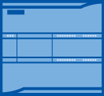
Design and handling S7-1200 CPU features (4/4) Integrated I/O and SB I/O options
 |  | 1211C | 1212C | 1214C | 1215C | 1217C
DI digital input | CPU | 6 | 8 | 14
 | SB | ≤ 4 (optional)
including HSC high-speed counters | CPU or SB inputs | 6
DQ digital output | CPU | 4 | 6 | 10
 | SB | ≤ 4 (optional)
AI Analog input | CPU | 2
 | SB | 1 (optional)
AQ analog output | CPU | - |  |  | 2
 | SB | 1 (optional)
Technological outputs
PWM / PTO pulse output | CPU or SB outputs | 4
 | Position-controlled axes (PROFIdrive, analog) | 8

Slide 22
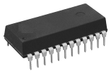

Design and handling S7-1200 load memory
✓
1, 2 or 4 MB (internal)
Tag names
Program blocks
✓
Comments
Data logs, recipes
Storing of the tag names and comments in the S7-1200 CPU memory and therefore online, available for project upload, etc.

Slide 23
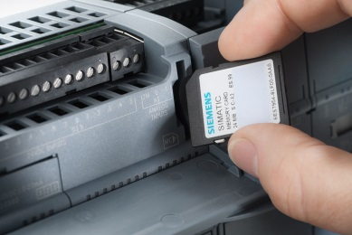
Design and handling Accessories – SIMATIC Memory Card
Capacity
SIMATIC Memory Card
4 MB
12 MB
24 MB
256 MB
2 GB
32 GB
What can be saved on a S7-1200 memory card?
Program
Data
System data
Recipes
Data protocol
Files
Projects
Increased lifespan 500000 write accesses possible
Project sent as an e-mail with transfer to memory card using standard PC
No special card reader required (SD card with FAT 32 file system)
No data lost despite openness with CPU shutdown
Increased copy protection – Option of linking the programs to the memory card serial numbers
SIMATIC MC optional usable

Slide 24

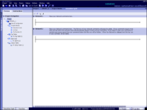
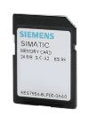
Design and handling How does the S7-1200 CPU use the SIMATIC memory card?
Program card
Transfer card
acting as a CPU memory.
Loss of all project and program data upon removal of a program card from the CPU.
Replacement and extension of the CPU-internal load memory
For transfer of project and program data into the CPU-internal load memory
Removal following data transfer ➔ CPU works with the data saved in your load memory.
For duplication of project and program data in multiple CPUs
Creation of a “transfer card” or “program card” with TIA Portal on a PC with an SD card slot
Notes:
S7-1200 SIMATIC memory card usage
Before programming a memory card the user must ensure that there is a valid network configuration available in your project so that the connection to the AS can be established following installation of the card.
SIMATIC memory cards are preformatted with a SIMATIC memory format which must not be modified. The two concealed files __log__ (system file) and crdinfo.bin (bin file) must not under any circumstances be deleted using a PC. The memory card may not be reformatted on the PC either; it will then be unusable.
The S7-1200 System Manual contains more detailed descriptions on creating and working with a program and transfer card.

Slide 25
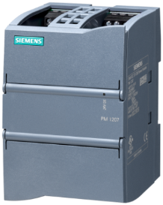
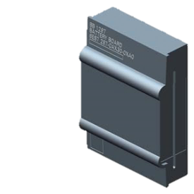
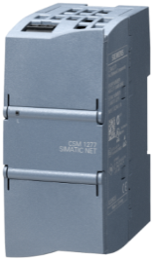
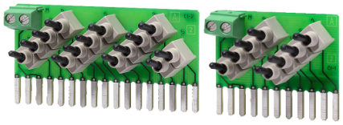
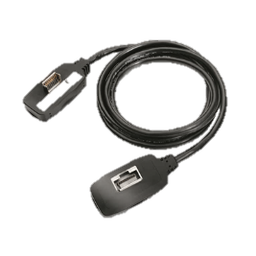
Design and handling SIMATIC S7-1200 accessories
Accessory part | Details
PM1207 Power supply | Inputs: 120/230 V AC 50/60 Hz, 1.2 A / 0.7 A Outputs: 24 V DC / 2.5 A
Battery board | for real-time clock long-term buffering (without CR1025 battery)
CSM 1277 Compact Switch Module | 4 x RJ45 jacks 10/100 MBit/s
Digital SIM 1274 input simulator
Analog input simulator | Potentiometer for direct entry of analog value
Extension cable | for 2-row station configuration, 2 m

Slide 26
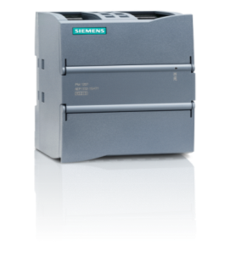
Design and handling PM 1207, the power supply for SIMATIC S7-1200
Optimum integration into the SIMATIC S7-1200 network
Uniform set-up technology and design
Universal assembly upon standard profile rail or wall assembly with screws
Integration in TIA selection tool
Fixed output voltage of 24VDC → therefore <33V output overvoltage protection. No danger of the user providing “too high voltage” to the CPU.
2-3 x rated current for 100ms upon startup → for short-term overloads, as the CPU has increased power requirements when switched on
Thermal design: Can be assembled on the left next to the CPU or communication assemblies with no mandatory clearance, without any negative effect on these (communication/CPU) assemblies through the heat generated through the power supply
Temperature range up to +60°C WITHOUT derating
Power failure backup of > 20ms, including with undervoltage at the input (93 / 187 VAC)
Easy connection to all single-phase networks through automatic range switching - prevents faulty operation
Slim construction width at 70 mm → saves space in the control cabinet
TECHNICAL DATA:
Input
Rated voltage AC 120/230 V
Automatic range switching
Working range AC 85…132/176…264 V
Output
Rated voltage 24 V DC +/-3%
Controlled isolated DC voltage (SELV)
Ripple/spikes <150/240 mVpp
Rated voltage 2.5 A
PowerBoost 2-3 x rated voltage for 100ms upon startup
Additional Information
Interference emission according to EN 55022 Class B (residential area)
Ambient temperature 0…+60°C
Dimensions (W x H x D) in mm: 70 x 100 x 75
Assembly upon standard profile rail or wall assembly

Slide 27
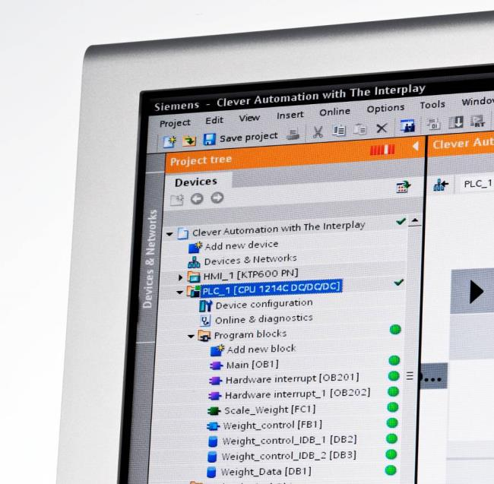
SIMATIC S7-1200 configured in the TIA Portal Modular and powerful.
Engineering software innovations for the SIMATIC S7-1200 …
STEP 7 Basic is integrated software for logic, HMI and networking with a common editor – Overall navigation and all icons and menus are uniform in all views. Easy to learn and therefore saves time
Automatic detection and load concept – Extremely fast hardware configuration in the development stage, all documentation is saved in the CPU (icons, comments, descriptions), far easier and more rapid maintenance
No separate standalone software programs - (And no separate configuration maintenance) for PID controller or motion control with PLC open instructions. Everything is integrated into the engineering software and is part of the user program
Integrated automation software for all your automation tasks
Notes:
3. Software Innovation
The most significant breakthrough for this product line is the Step 7 Basic programming software
The industry first One Software – One User Program for Controller, HMI, and Networking This type of integrated functionality has never been available in traditional Micro or Nano PLCs. Only commonly found in much larger controller classes, Specialized or PC-Based Control packages.
All configuration begins from the Central Navigation Portal. Easy to start and efficiently manage projects, no separate icons for each Add-On
Common navigation layout for each editor, I/O Config, Logic, HMI Config, Motion, Networking, PID Tuning. Consistent navigation, easy to learn and remember
All editors are drag-drop interactive, all in the same instance. No need to save/close or import/export between them.
The New Step 7 Basic provides Integrated Automation development software specifically for the Compact Controller class

Slide 28
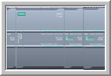
Efficient engineering S7-1200 interrupt structure
FB
FC
Hardware
OS
OB1
Instance
The assignment of events to OBs can occur during configuration or at runtime
Cyclical
FC
OB 100
FC
Startup
Global
OB 20x
Time
FC
Global
Interrupt - processing
OB 20x
Process
FC
FB
OB 82
Instance
Diagnostics
FC
As with S7-1500 all OBs are interrupt-capable as standard, but all OBs (expect for OB1) can be configured as not interrupt-capable.

Slide 29
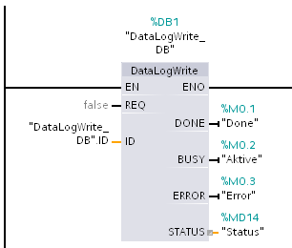
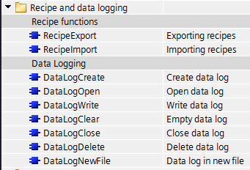
Efficient engineering Recipes and data logging
DataLog (archive)
Recipes
Cyclical & event-triggered storage of tags, incl. string tags
e.g. Saving of operating data, error information, ....
Storing of the data in the *.csv file on a memory card or internal memory
Archive downloads via Webserver
Input recipes via *.csv file and save on card
e.g. Machine configuration, initial values, tool-dependent configuration data
Storing of the data in the *.csv file on a memory card or internal memory
Upload & download of the recipes via Webserver

Slide 30

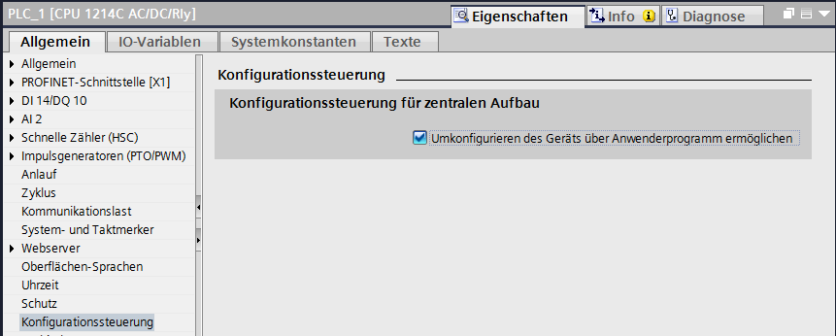
Efficient engineering Configuration control (option handling) in the central setup
Configuration control in the central setup
Maximum configuration:
Options:
A, B, C, D
A
B
C
D
Different hardware configurations provided in the controller:
Configuration modified in the user program (OB100 startup)
Options added on at the end of the configuration
Support for CM/CP/SB/CB/SM with S7-1200
Configuration upon delivery:
Options:
A, D
A
D
Machine update:
Options: A, D, C
A
D
C

Slide 31
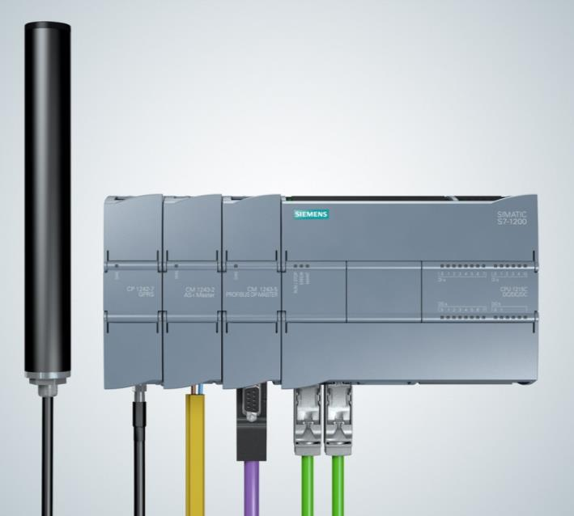
SIMATIC S7-1200 configured in TIA Portal Highlight performance
Comprehensive network options for SIMATIC S7-1200
PROFINET Master – decentralized Profinet architectures possible for I/O, HMI, drives, and other Profinet field devices. NO communication module required!
PROFIBUS Master & Slave – decentralized Profinet architectures possible for I/O, drives, and other Profinet devices, including integration into existing system networks.
AS-i Master – The new AS-i-Master is configured in full in the TIA Portal and a new AS-i network can be created very easily with just a few clicks. AS-i networks do not therefore require separate software!
CANopen Master – Enables connection with CANopen devices, as well as with devices running Transparent CAN 2.0A.
Comprehensive network options to meet your requirements!

Slide 32
SIMATIC S7-1200 configured in TIA Portal Highlight performance
Comprehensive network options for SIMATIC S7-1200
Modbus TCP – Enables communication with devices as Modbus master or slave. Only one TCP function block is required for this.
IO-Link Master – Fast and easy integration of the SIRIUS compact starter, M200D starter and SIRIUS soft starter for simple starter control.
GPRS/LTE module – Easy implementation for data recording and control of decentralized computer.
TCP/IP – Via the instructions for open communication you can communicate with other CPUs, other PCs and with devices that use TCP/IP communication protocols as standard. NO communication module required!
Comprehensive network options to meet your requirements!

Slide 33
SIMATIC S7-1200 in the TIA Portal Highlight performance
Comprehensive network options for SIMATIC S7-1200
RS-485, RS-422 & RS-232 – The S7-1200 CPU supports point-to-point (PtP) communication for character-based serial protocols, and this provides maximum freedom and flexibility for the use of PtP communication instructions in the user program.
Modbus RTU – Using the Modbus instructions the Modbus master or slave is able to communicate with devices that use the Modbus RTU protocol.
USS – Using simple USS instructions you can control the operation of drives that support the USS (Universal Serial Interface) protocol
Comprehensive network options to meet your requirements!

Slide 34



Communication S7-1200
Module | Communication
CM 1241 | RS232 | serial
CM 1241 | RS422/485 | serial
CM 1243-2 | AS-i master
CM 1242-5 | PROFIBUS | DP slave
CM 1243-5 | PROFIBUS | DP master
CP 1242-7 | GPRS | Mobile communications telecontrol
CP 1243-7 | LTE | Mobile communications telecontrol
CP1243-1 | Ethernet | VPN/Firewall, Telecontrol Ethernet (DNP3, IEC 60870)
RF120C | RFID | 1 Reader port; RS422
CM CANopen | CANopen | 3rd party: HMS
CM CP
CPU
SM
CB 1241 RS485
SM 1278
USS MODBUS RTU
SINAMICS V20

Slide 35


Communication S7-1200 integrated PROFINET (Ethernet) interface
Communication ...
… with the STEP 7 software
CPU hardware configuration
Loading a project
Monitoring/amending runtime tags
Set runtime I/O statuses
Diagnostics information
... with HMI panels
Data from or to the CPU
System diagnostics
... from CPU to CPU
Open communication with T-block instructions
Supported protocols: TCP/IP, ISO on TCP, UDP, S7 Com. (PUT/GET)
S7-1200 CPUs use PROFINET connections to STEP 7, S7-1200 CPUs and HMI panels
Notes:
S7-1200 Ethernet communication
The PROFINET port for the CPU supports simultaneous communication connections:
OPC Server (Object Linking and Embedding – OLE) for Process Control Server. OPC functionality is possible with the SIMATIC NET OPC server.
PROFINET functionality including controller and device
The S7-1200 Ethernet interfaces are designed as PROFINET and support PROFINET IO and iDevices.
Communication with third-party devices via Ethernet is supported. The S7-1200 provides a “native” Ethernet-TCP/IP protocol (“FreePort” for Ethernet) for user-specific development of this functionality. Communication is possible with third-party PLCs if these support the same Ethernet connectivity as S7-1200.

Slide 36










Communication MRP - Media redundancy protocol
S7-1200
S7-1500
Based on ring topology (IEC 61158-5-10)
Max. 50 nodes in the ring
PROFINET IO-Controller
PROFINET IO-Devices
Components of the network infrastructure (IE switches)
200 ms reconfiguration time
CPU 1215/17 as MRP Client at least FW V4.1
Configuration and diagnostics in STEP7
< V4.2
> V4.1
PROFINET
Industrial Ethernet
Improved plant availability
More flexibility
Lower costs since less equipment required

Slide 37





Communication S7 routing
S7-1200
S7-1500
Enables a connection between different subnets
A SIMATIC S7-1200 station acts as an S7 router
Based on PROFINET
Actually only with CP 1243-1 at least V2.0 (6GK7243-1BX30-0XE0) and CPU FW V4.2
S7 routed
Connection
177.168.0.1
Subnet 1
192.168.0.1
192.168.0.3
192.168.0.2
Subnet 2
Routing between the CPU and a CP, e.g. for transfer an HMI project from ES to panel

Slide 38


Communication Webserver
Communication ...
Integrated Web server
Access to system and process reports as well as identification data
System diagnostics for all configured assemblies centrally and decentralized
Communication diagnostics on parameters, statistics, connection status
Access to process data via tag tables and freely definable tag lists
Pages to be defined by the user
Firmware update
Archive
Access via Webserver using Filebrowser for reciprocal exchanges of data in .csv format
Logging of user-defined tags
Simple location-independent information recording for process variables and system status

Slide 39





Communication Station webserver
Remote access via Internet/mobile communications
PN access
Various types of communication access: CPU PN interface, CP 1243-7 LTE, CP1242-7 V2
Central access via CPU page independently of the interface
User is then able to browse to the CP-specific webpages from there
uniform, consistent webserver for entire S7-1200 station

Slide 40







Communication SIMATIC apps
Description:
Secure access via app to the webserver for your SIMATIC S7-1200/1500 and ET200SP
Supported firmware:
SIMATIC S7-1200: V3.0 or higher
SIMATIC S7-1500/ET200SP: V1.8 or higher
Functions:
Detect up to 50 networked CPUs via HTTPS and established a connection
Change CPU operating mode (RUN/STOP)
Read out CPU diagnostics information and send via e-mail
Change tags
Monitor up to 8 tags in the curve display
High security: 1. Encrypted communication (AES256) 2. Encrypted profile data
3. Password required when starting the app
4. Password required to establish the connection
SIMATIC S7 App (Q2/2015)

Slide 41

Communication PROFINET i-Device
Simple configuration of S7-1200 CPUs in a master/slave architecture through reading and writing the reciprocal I/O images
Connection of CPUs in different projects
NO PN-PN coupler required (transparent network)
IO controller
IO device
CPU1
CPU2
IE / PROFINET
Operational system
Operational system
IO controller 1
Application / user program
Application / user program
i-device
IE / PROFINET
IO device 1
IO device 2
IO device 3
IO process image
IO process image
Input addr.
Output addr.
Input addr.
Output addr.
PROFINET IO
Savings with costs / installation / wiring of additional hardware

Slide 42




Communication Shared I-Device
Shared I-device
Access for up to 2 controllers on S7-1200 as i-device
Rapid exchange of data in real time between S7-1x00 CPUs
Incorporation of 3rd party controllers under PROFINET
Controller 1
Controller 2
As of V4.1

Slide 43

Communication Serial communication
S7-1200 CPU communication via RS232 and RS485 connections
ASCII protocol (character-based serial communication) uses STEP 7 PtP instructions
USS Drive protocol is programmed with STEP 7 USS library instructions
MODBUS protocol is programmed with STEP 7 MODBUS library instructions
3964R Protokoll
RS232
RS485/422
Use of RS232 and RS485/422 modules CM1241 or RS485 Signalboard CB1241 for PtP communication
Notes:
Serial communication with the S7-1200
MODBUS RTU is possible for both RS485/422 and RS232 signal modules.
The USS library is supported on the RS485 port and is included in STEP 7 Basic.
The CM 1241 RS232 module supports handshaking.
The S7-1200 RS232 and RS485/422 modules feature galvanically isolated connections.

Slide 44

Communication USS drives
PZD parameters – Up to eight user-defined PZD parameters for control and speed
Update rate
Fixed update rate (as fast as possible)
Enable instructions in an interrupt alarm OB in order to set a user-defined update rate.
Support for drives
Maximum 15 drives per CM (communication module) supported
Non support:
MM3 drives
Deregistration of missing drives

Slide 45


Communication IO-Link support
IO link master specification V1.1
S7-1200 CPU up to 8 IO-Link master modules - centralized
Data rate COM1 (4.8 kbaud), COM2 (38.4 kbaud), COM3 (230.4 kbaud)
Standard IO Mode (SIO Mode)
up to 4 IO‑Link devices (3 wire) or 4 standard actuators
Diagnostics configurable for each port
I&M identification
IO‑Link parameter allocation with S7‑PCT (Port Configuration Tool) V3.2

Slide 46



Communication SM 1278 4xIO-Link master (6ES7 274-1XK30-0XA0)
Point-to-point connection, no bus system
Existing wiring topologies are retained
Standard sensor/actuator cable (three wires with one signal wire), unshielded, 20 m in length, no special-purpose cable / connector
Manufacturer-independent communication standard for the PNO
Non-stop consistent communication
Cyclical, bidirectional process data communication (typ. 2 ms cycle)
Non-cyclical service data transmission between sensors/actuators and the controller as required
Integrated differentiated diagnostics alarms
→ Link
Control cabinet
3UG4 monitoring relays
<20 m
Switching devices
3RW40 soft starters
3RA27 function modules for feeders
<20 m
3RA6 compact starters

Slide 47





Communication IO-Link Support ➔ Engineering

Slide 48


Communication SIMATIC RF120C – Fast communication module
Integration in TIA Portal (from V12 SP1)
Full integration into the device configuration for the TIA Portal
Simple function blocks for fast programming
One reader per RF120C
So that the data is available to the application immediately
Up to three RF120C can be operated in parallel to the left of the CPU
Reader cable
Submin-D connector on RF120C;
Ready-made cables are available
Firmware update via SIMATIC Manager
Rapid bug fixes via ONLINE update (up to the reader)
Order number: 6GT2002-0LA00
S7-1200 and RF120C: cost-effective and powerful identification solution

Slide 49
Communication SIMATIC RF120C – Fast communication module for S7-1200
RF120C
Interface to the application | Internal S7 bus
Connection technology | S7-1200 setup technology; screw terminals for 24 V supply
Interface to the reader | RS422 incl. 24 Volt; up to 115.2 KBaud
Connection technology | Submin-D connector
RFID system | RF200, RF300, RF600, MOBY D/U, MV400
FB, driver | Instructions: Read, Write, Read_EPC-Mem, Write_EPC-Mem, Set_Ant_RF300, Set_Ant_RF600, Reset_Reader; based on FB101
Number of readers | 1 per RF120C; 3 per S7-1200
Degree of protection | IP 20
Dimensions (W x H x D) | 30 x 100 x 75

Slide 50



SIMATIC S7-1200 SIWAREX WP231 – Basic applications
Supported S7-1200 CPU:
Applications:
CPU 1212C → up to two SIWAREX modules
CPU 1214C or higher → up to eight SIWAREX modules
Full parameter access from the CPU via free downloadable function block → Complete commissioning and calibration via CPU/HMI
Level measurement in silos and bunkers
Plattform scales
Force and tension measurements
Typical industries: Food & Beverage, Chemicals, Cement, Aggregate
Legal for trade certificate according OIML-R76
Connection options:
Up to eight parallel connected analog 350 Ohm load cells per SIWAREX (1mV/V, 2mV/V, 3mV/V or 4mV/V)
1 SIWAREX = 1 scale
4 digital inputs / 4 digital outputs
1 analog output
Ethernet (Modbus TCP & SIWATOOL)
RS485 (Modbus RTU)

Slide 51




SIMATIC S7-1200 SIWAREX WP241 – Belt weigher applications
Supported S7-1200 CPU:
Applications:
CPU 1212C → up to two SIWAREX modules
CPU 1214C or higher → up to eight SIWAREX modules
Full parameter access from the CPU via free downloadable function block → Complete commissioning and calibration via CPU/HMI
Belt scales (Cement-, Aggragate plants, Mines, Food & Beverage plants)
Weigh feeder applications (Food & Beverage, Chemical, Steel)
Connection options:
Up to eight parallel connected analog 350 Ohm load cells per SIWAREX (1mV/V, 2mV/V, 3mV/V or 4mV/V)
1 SIWAREX = 1 scale
3 digital inputs / 4 digital outputs / 1 speed sensor input
1 analog output
Ethernet (Modbus TCP & SIWATOOL)
RS485 (Modbus RTU)

Slide 52

SIMATIC S7-1200 SIWAREX WP251 – Dosing , Batching and Bagging applications
Supported S7-1200 CPU:
Applications:
CPU 1212C → up to two SIWAREX modules
CPU 1214C or higher → up to eight SIWAREX modules
Full parameter access from the CPU via free downloadable function block → Complete commissioning and calibration via CPU/HMI
Dosing and batching scales (Chemical-, Food-, Pharma, Packaging industries)
Bagging machines (Bulk solids industries)
Eichfähig gemäß OIML-R51, R61 und R76
Connection options:
Up to eight parallel connected analog 350 Ohm load cells per SIWAREX (1mV/V, 2mV/V, 3mV/V or 4mV/V)
1 SIWAREX = 1 scale
4 digital inputs / 4 digital outputs
1 analog output
Ethernet (Modbus TCP & SIWATOOL)
RS485 (Modbus RTU)
RS485 (Modbus RTU)

Slide 53


Communication Controller Area Network CANopen 021620-B
SIMATIC S7-1200C CANopen master/slave
A CANopen connection to a S7-1200 system enables integration between devices and the S7-1200 system
Up to 3 CANopen modules per S7-1200 CPU
Connection type to the CAN: 9-pin DSUB (male)
Up to 16 CANopen nodes per module
256 bytes each for inputs and outputs with the CANopen module
Can be integrated in the hardware catalog of the TIA Portal configuration suite
Ready-made function blocks for simple PLC programming available in the TIA Portal
→ Link
Easy integration in CANopen applications

Slide 54


Communication MODBUS communication
MODBUS RTU protocol
Use of a CM or CB 1241 module for serial communication
MODBUS instructions of the communication module for simplified MODBUS RTU operation.
MB_COMM_LOAD for basic initialization of the master and slave operation
MB_MASTER and MB_SLAVE for controlling the report and connection allocations
Modbus addressing supports a maximum of 247 slaves (slave numbers 1 to 247).
Maximum of 32 devices per segment in the Modbus network depending on the loading and drive functions of the RS485 interface
Repeater required if using more than 32 devices to extend to the next segment
MODBUS TCP protocol
Open User Communication MODBUS TCP instructions use the PROFINET port integrated in the CPU

Slide 55

Communication Overview of CP 1243-1 product features
CP1243-1 (6GK7243-1BX30-0XE0)
Single-width S7-1200 enclosure (30 x 110 x 75)
Temperature range in operation: -20°C to +70°C
Standard rail mounting
Diagnostic LEDs (overall status and detail)
Power supply using backplane bus
1 x Ethernet Port RJ45 (10/100 Mbit/s) for connecting a modem/router such as SCALANCE M
Integrated security functions (VPN and Firewall)
Integration to Scada Systems via Telecontrol Protokolls (DNP3, IEC 60870)
Communication Processor for connecting S7-1200 to Ethernet network with additional Interface and security features firewall and VPN. Integration to Scada Systems via Telecontrol Protokolls (DNP3, IEC 60870, Telecontrol Basic).

Slide 56

Communication Overview of CP 1243-7 product features
CP1243-7 (6GK7243-7KX30-0XE0 – EU version 6GK7243-7SX30-0XE0 – US version)
1 connection to LTE (4G) mobile network (different versions for EU and North America)
Single-width S7-1200 enclosure (30 x 110 x 75)
Temperature range in operation from -20ºC to +70ºC
Standard rail mounting
Diagnostic LEDs (overall status and detail)
Integrated security functions (VPN and Firewall)
Access to the CPU Webserver
Email and SMS Alarms
Process Monitoring and Control via Cellular network
Communication processor to connect SIMATIC S7-1200 via LTE (4G) mobile network to control point system with TeleControl Server Basic

Slide 57












SIMATIC S7-1200 PROFIBUS communication DP master CM 1243-5 and DP slave CM 1242-5
Communication for S7-1200 CPUs according to PROFIBUS standard IEC61158/61784
PROFIBUS DP-Master CM 1243-5
Connection for up to 16 DP slaves
PG/OP communication: up to 4 connection for HMI and 1 connection for PG
S7 communication: 4 S7 connections to other S7 stations with PUT/GET
PROFIBUS DP-Slave CM 1242-5
as an intelligent DP slave for communication for the S7-1200 with any other DP master

Slide 58



SIMATIC Integrated Technology S7-1200 / S7-1500 – integrated compact controllers
PID Compact
PID 3-Step
Technical features
Continuous PID controller for proportional-acting actuators
Analog or pulse-width modulated (PWM) output
PID controller for integrating actuators (e.g. valves) with digital signals for opening and closing
Output for analog and binary valve control
Position feedback/ stop signal
Integrated motor regulating time measurement
Closed-loop control structures: PI, PID
Inversion of control direction, anti-windup and weighting of P and D portion
Actual value scaling, alarms for actual and target values
Manipulated variable limitation
Parameter setting for conduct in the event of fault
Two-stage optimization procedure with optimization in the operating point

Slide 59


SIMATIC Integrated Technology S7-1200 / S7-1500 – integrated compact controllers
Integrated PID controllers
For versatile control tasks
Continuous controllers and step controllers
Automatic determination of the controller parameters
Manageable configuration screens
Commissioning screens with integrated trace
Available in S7-1200 and S7-1500 (integrated in FW)
Cost savings through integrated PID controllers with premium auto-tuning

Slide 60


SIMATIC Integrated Technology S7-1200 / S7-1500 – integrated compact controllers
PID Temp – Temperature controller for actively heating and cooling a process
Two controller parameter sets for heating and cooling – alternatively: cooling factor
Analog or pulse-width modulated control signals for heating and cooling
Integrated two-stage self-optimization – specifically for temperature processes
Heating and cooling optimization available separately (multi-zone applications)
Deadband and control zone can be set
Cascade control with anti-windup
Notes:
Active heating and active cooling elements are frequently used to control the temperature.
The temperature controller provides two separate outputs for connecting the actuators. The temperature controller used two separate PID parameter sets in order to account for the response times of the heating and cooling elements which are generally very different. These allow more rapid and precise controls.
Extrusion systems in the plastics industry:
plastic granules are fused via different temperatures zones. The first zones can normally be heated as well as cooled.
The temperature controller also provides synchronization mechanisms for control optimization for such applications.
Cascade control: multiple control loops are ‘nestled’ in each other (in the image: chocolate melting)
Advantages: improved fault response, subordinate control loops have a linearizing effect

Slide 61
SIMATIC Integrated Technology - PID Control S7-1200 / S7-1500 – integrated compact controllers
 | Memory requirements for the instance DB |  | CPU processing time (typical)
PID Compact | Load memory approx. | 12000 bytes | CPU 121xC (FW>=4.1) | 300 µs
 | Work memory | 788 bytes
 | Residual work memory | 44 bytes | CPU 1511/16/18 (FW>=1.7) | 85/50/4 μs
PID 3-Step | Load memory approx. | 15000 bytes | CPU 121xC (FW>=4.1) | 410 µs
 | Work memory | 1040 bytes
 | Residual work memory | 60 bytes | CPU 1511/16/18 (FW>=1.7) | 120/65/5 μs
PID Temp | Load memory approx. | 17000 bytes | CPU 121xC (FW>=4.1) | 580 μs
 | Work memory | 1280 bytes
 | Residual work memory | 100 bytes | CPU 1511/16/18 (FW>=1.7 | 130/75/6 μs

Slide 62


SIMATIC S7-1200 Technology integrated
Control functionality
Flexible drive connection via PROFINET, PROFIBUS or analog interfaces
CPU 1217C with 1.5 V differential outputs for speed and position control up to 1 MHz
Easy programming of the motion processes with PLCopen Motion Control blocks
Uniform configuration for controller/HMI/drives
Convenient diagnostics and commissioning tools (control panel, trace)
Easy troubleshooting using automated alarm messages to the engineering system
Wizard for motion control technology with PTO/PWM
Easy scalability through integration of the same Motion Control functions in all controllers

Slide 63


SIMATIC S7-1200 Technology integrated - Possible drive versions
Controlled operation via Pulse-Train Interface (PTO)
Simple onboard interface without position feedback
Number of drives dependent on the CPU type
For step-motor drives or servo drives with pulse interface
Position-controlled operation
Can be used on all CPU types
HSC possible as encoder connection
Up to 8 drives
Absolute value encoders supported (no overflows permitted)
PROFIdrive drives
For all Sinamics PROFINET/PROFIBUS drives
Servo or frequency inverter
Analog drives
Plenty of analog Siemens and third-party drives available
Step-motor drive
or servo drive
Drive
Power
PLC
PTO signal
Enable
Motor
Ready
Servo inverter
Drive
Power
PLC
PTO signal
Enable
Encoder
Motor
Ready
Data exchange
Encoder data
Notes:
Background:
There are only a few Siemens drives that can be connected via PTO
This is also not possible with all 1200 CPUs, and only with the DC/DC/DC version or via special signal boards
Position-controlled axes is therefore the real method for connecting all 1200s with drives as openly as possible
Difference with 1500:
Never isochronous
Incremental encoders can be connected cost-effectively to the CPU (HSC)

Slide 64

SIMATIC Technology integrated Counting and measuring with high-speed counters (HSC)
 | 1214C | 1217C
Max. number of HSCs permitted | 6 | 6
1 MHz max. single-phase | 0 | 4
1 MHz max. A/B counter | 0 | 2
100 kHz max. single-phase | 6 | 6
80 kHz max. A/B counter | 3 | 3
30 kHz max. single-phase | 4 | 4
20 kHz max. A/B counter | 2 | 2
. . .
Incremental encoder
The two-phase or A/B rotary encoder is the incremental encoder most often used as a result of its improved accuracy.

Slide 65


SIMATIC Technology integrated High speed counter HSC - Gate input
Use case: Measurement of components on a conveyer.
Advantage: Measurements can be realized easily. Since FW 4.2 are no additional OBs necessary (OBs = interrupts).
After the probe was passing the light barrier the length is measured. Independent of incoming pulses the last value is fix on the input double word.
Gate
Count
Notes:
Z.B. zur Messung von Rundhölzern oder Kanthölzern mit einer Lichtschranke (Gate Eingang) und einem Drehgeber am Förderband. In FW >V4.2 mussten für Steigende und Fallende Flanke der Lichtschranke ein OB zum auslesen des Zählwertes „:P“ Projektiert werden. Durch Wegfall der OB Laufzeit ist die Genauigkeit deutlich verbessert

Slide 66

SIMATIC Technology integrated High speed counter HSC - HSC Output
Use case: exact marking of components
Advantage: A output can activated easily. There is no additional OB necessary since FW 4.2 (OBs = interrupt) .
After pulse time was running the output is reasserted without user program action
Output
Gate
Count

Slide 67

SIMATIC Technology integrated High speed counter HSC - Capture input
Use case: capture input
Advantage: This feature copy the current counter value to the capture register with change on an digital input. The Register investigation can be done later on without using any additional interrupt OBs
Gate
Capture
Count
Notes:
Z.B. zur Messung von Rundhölzern oder Kanthölzern mit einer Lichtschranke (Gate Eingang) und einem Drehgeber am Förderband. In FW >V4.2 mussten für Steigende und Fallende Flanke der Lichtschranke ein OB zum auslesen des Zählwertes „:P“ Projektiert werden. Durch Wegfall der OB Laufzeit ist die Genauigkeit deutlich verbessert

Slide 68


SIMATIC Technology integrated PWM Pulse-width modulation - Flexible frequency output
Function: Flexible frequency output
Use case:
Simulation of single phase encoders
Output of an analogue value as frequency
Generating of sound
Stroboscope for rotary speed check or product detection
Laser cutting, frequency (for die wave length) and also pulse with (for power) can adjusted.
Cluing, numbers and size of clue dots can be changed
since FW4.2
variable frequency
since FW4.2
30
20
10
50 50
50 50
50 50
fix pulse/pause relation
30
variable frequency
20
10
50 50
60 40
80 20
Fix pulse/pause relation

Slide 69
SIMATIC Technology integrated High speed counter HSC plus PWM - Test setup
Use Case: the length and the speed of an component should be measured
Solution: Pulse output create 100kHz which are connected to the HSC count input. The inputs Gate, Capture, Sync are connected to light brakes. The calculation of speed and length can be done in a slow main cycle. No additional hardware OB is necessary
PWM out 100KHz
Gate
Capture
Sync bei steigenderFlanke
Count
50,8mm

Slide 70


SIMATIC Technology integrated Period measurements with high-speed counters (HSC)
Multiple counter events in one measurement interval
Zero and one counter event in multiple measurement intervals

Slide 71





Integrated system diagnostics
Configuring instead of programming
Integrated system diagnostics for the centralized setup are active by default. You only configure the following as required: checkbox for high/low analog range, wire breakage, power failure, etc.
Automated updated of the diagnostics information with new HW components, no additional effort required
System diagnostics information possible in the CPU-STOP
Uniform display concept
Uniform clear text information in the TIA Portal, Webserver, HMI & SIMATIC app
Efficient fault analysis through a uniform display concept

Slide 72


SIMATIC S7-1200 Diagnostics in real time - Trace for the S7-1200
Recording of up to 16 different tags in separate CPU memory
Up to 2 independent trace jobs supported simultaneously
Cycle-granular recording (real time) so that no value is lost
Versatile trigger conditions for filtering out the event
Recording takes place independently of the engineering system on the CPU for simple searches of sporadic faults
Exportable measurements for documentation and user-specific processing (csv and ttrec file)
Program and application diagnostics in real time for detection of sporadic faults

Slide 73







SIMATIC S7-1200 Trace - Repeated measurements stored on memory card
S7-1200
S7-1500
Measurements stored on SMC
TIA Portal
Webserver
onlyS7-1500
Repeated measurement
Record N measurements according trigger conditions
Activate the trace after completing a measurement
Option: overwrite the oldest measurement
Up to 1000 measurements on card
Customer benefit
RAM*
Persistent storage of measurements
Significantly more Trace Data for established Analysis
CPU
*excl. f. Traces

Slide 74


Security Integrated Increased know-how protection in STEP 7
Password protection from unauthorized opening of the program blocks with STEP 7 and therefore protection from unauthorized copying or e.g. developed algorithms
Password protection from unauthorized evaluation of the program blocks with external programs
from the STEP 7 project
from memory card data
from program libraries
Protection of intellectual property and investments made

Slide 75

Security Integrated Increased copy protection
Linkage of individual blocks to the serial number for the memory card or CPU
Protection from unauthorized copying of program blocks with STEP 7
Protection from unauthorized duplication of the configuration on the memory card
Protection from unauthorized reproduction of executable programs

Slide 76

Security Integrated Dynamic copy protection with mandatory password
Copy protection with different methods for providing a target serial number:
Program block with static linkage
Program blocks with dynamic linkage
Static linkage: direct configuration of a target serial number (from memory card or CPU) for program blocks
Dynamic linkage: automatic detection of a target serial number with linkage to this target serial number during the download on the CPU or memory card
TIA Portal Project
Target serial number:
As of V4.1
12345678
and
Automatic detection
Download with check of the serial number by the controller
Download with auto- matic integration of the serial number by the TIA Portal
Advantages:
Both cases involve linkage of the block to a special HW serial number for the CPU or the memory card
A block with dynamic linkage in the TIA Portal project is not tied to a certain serial number but is protected via an additional password for copy protection (from STEP 7 V13 SP1)
Automatic serial number configuration and simple linkage for machine manufacturers
Simple mass download with copy protection for authorized person only
S7 Controller
Program blocks with active copy protection
12345678

Slide 77


Security Integrated Increased manipulation protection
Improved protection from manipulation of the communication with access to the controller by digital checksums
Protection from network attacks such as infiltration of fake / recorded network communication (replay attacks)
Protected transfer for passwords upon authentication
Detection of manipulated firmware updates through digital signatures
Protection of communication from unauthorized manipulations for maximum system availability

Slide 78





SIMATIC Technology integrated Extended Know How protect - Copy prevention external load memory
Optional – protection against copy the project by using a transfer card
Prevention unauthorized project copy
Use a transfer SD card to recover the use of the CPU for a customer that has forgotten his password.
Notes:
an empty SD card (no Job file) causes no CPU action. ILM is not copied to ELM and ILM is not erased.
a blank PROGRAM SD card causes no CPU action. ILM is not copied to ELM and ILM is not erased.
a transfer SD card (TO_ILM) causes the CPU to replace ILM with the contents of ELM.
No change in the evaluation of any other SD card types.

Slide 79

Security Integrated Access protection
Extended access protection
via Security CP 1243-1 through integrated Firewall and VPN
Comprehensive protection against unauthorized configuration changes.

Slide 80

Safety integrated S7-1200 Failsafe …a unique, innovative and efficient safety solution
Type and part reduction
Standard and fail-safe automation with just one controller
PROFINET integrated
+
Certified in accordance with EN 61508 ^{2nd} Edition up to SIL 3 and EN ISO 13849-1 up to Pl e
Established coded processing instead of multi-processor system
+
Integrated diagnostics
Rapid fault finding via granular reporting in clear text …including globally via WEBserver
+
investment protection
Extend existing system simply with Safety
Simple porting of existing user programs between S7-1200 <> S7-1500
+
Maximum manipulation protection
Additional password protection for access to F configuration and F program
+
Notes:
80

Slide 81




Safety integrated SIMATIC S7-1200 Failsafe portfolio
Failsafe S7-1200 CPUs
STEP 7 Safety Advanced V14 SP1
CPU 1212FC DC/DC/DC
CPU 1212FC DC/DC/Rly
CPU 1214FC DC/DC/DC
CPU 1214FC DC/DC/Rly
CPU 1215FC DC/DC/DC
CPU 1215FC DC/DC/Rly
Fail-safe S7-1200 and S7-1500 supported
Graphical user interface (GUI), online help:
Documentation:
Failsafe S7-1200 IO modules
STEP 7 Safety Basic V14 SP1
SM 1226 F-DI 16 x 24VDC
SM 1226 F-DQ 4 x 24VDC
SM 1226 F-DQ 2 x Relay
Functional such as Safety Advanced for fail-safe S7-1200
Graphical user interface (GUI), online help:
Documentation:

Slide 82

Subject to changes and errors. The information given in this document only contains general descriptions and/or performance features which may not always specifically reflect those described, or which may undergo modification in the course of further development of the products. The requested performance features are binding only when they are expressly agreed upon in the concluded contract.
All product designations, product names, etc. may contain trademarks or other rights of Siemens AG, its affiliated companies or third parties. Their unauthorized use may infringe the rights of the respective owner.
siemens.com

